Slide 1

Potato Leaf Disease Classification Using an Efficient CNN
Early identification of potato leaf diseases is vital for minimizing crop losses and enhancing agricultural productivity. This study presents a lightweight convolutional neural network designed for efficient potato leaf disease classification with rapid training convergence.

Slide 2

The Challenge in Agriculture
Traditional Diagnosis
Deep Learning Limitations
Conventional disease diagnosis relies on manual inspection by experts—labor-intensive, subjective, and difficult to scale in large farming environments.
Existing deep learning solutions use computationally heavy architectures, resulting in slow training convergence and limited feasibility for resource-constrained agricultural settings.

Slide 3
Research Gap & Innovation
Prior Approaches
Our Solution
Key Innovation
Prioritize accuracy through deep, computationally expensive architectures or focus on inference efficiency without addressing training convergence.
Task-specific CNN architecture that simultaneously balances classification accuracy, fast convergence, and computational efficiency.
Achieves 98% accuracy within only 10 training epochs using lightweight design optimized for rapid convergence.

Slide 4
Dataset & Methodology
2,152
Three Disease Categories
Potato Early Blight
Total Images
Potato Late Blight
Healthy Potato Leaves
Labeled potato leaf images across three categories
Data augmentation strategies included random horizontal flipping, vertical flipping, and rotation to enhance generalization and reduce overfitting.
80/20
Data Split
Training to validation ratio
224×224
Image Size
Uniform spatial resolution

Slide 5
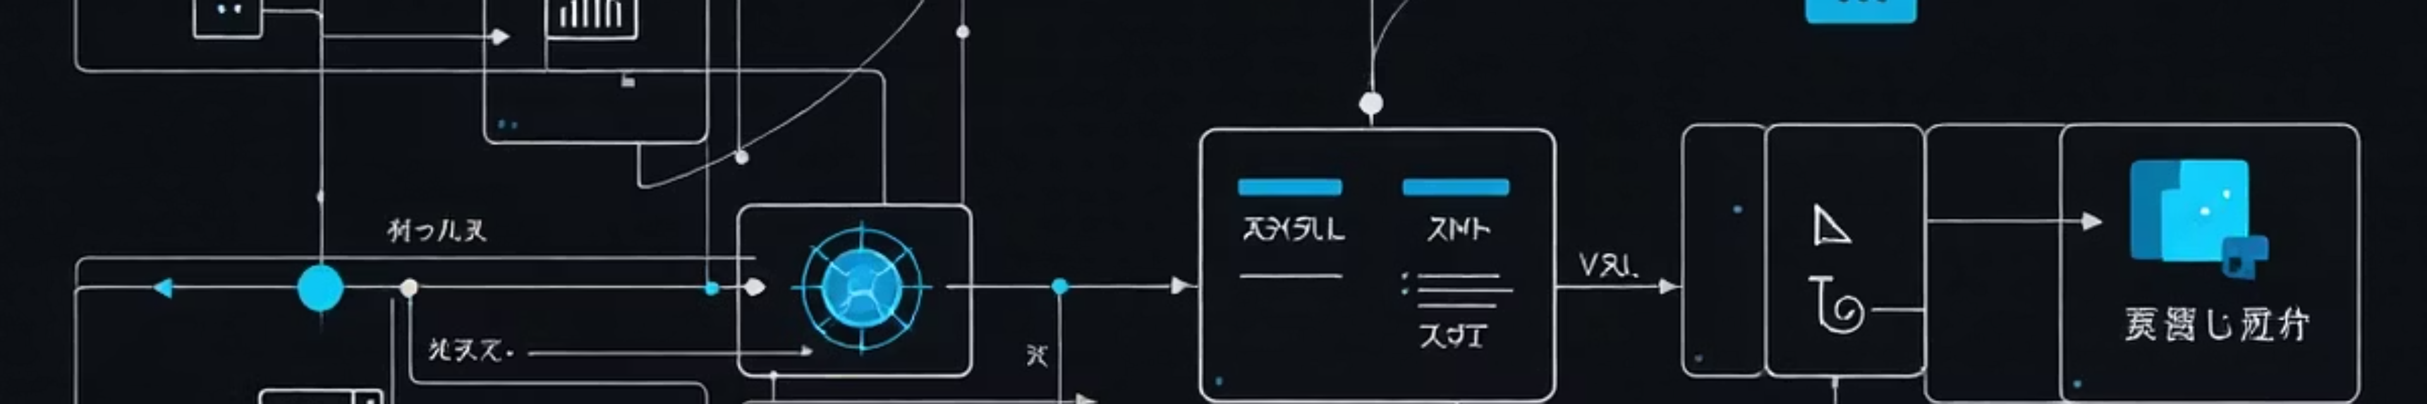




Lightweight CNN Architecture
Block 1
Block 2
Conv2D (32 filters) → Batch Normalization → ReLU → Max Pooling
Conv2D (64 filters) → Batch Normalization → ReLU → Max Pooling
Block 3
Classifier
Conv2D (128 filters) → Batch Normalization → ReLU
Global Average Pooling → Fully Connected → 3 Classes

Slide 6



Key Design Innovations
1
2
Batch Normalization
Global Average Pooling
Stabilizes training dynamics and accelerates convergence by normalizing feature distributions, enabling higher learning rates.
Replaces parameter-heavy fully connected layers, reducing complexity from O(M·N) to O(d·C) while preserving discriminative representations.
3
Adaptive Optimization
Adam optimizer with ReduceLROnPlateau scheduler and early stopping prevents overfitting and reduces unnecessary computational overhead.

Slide 7
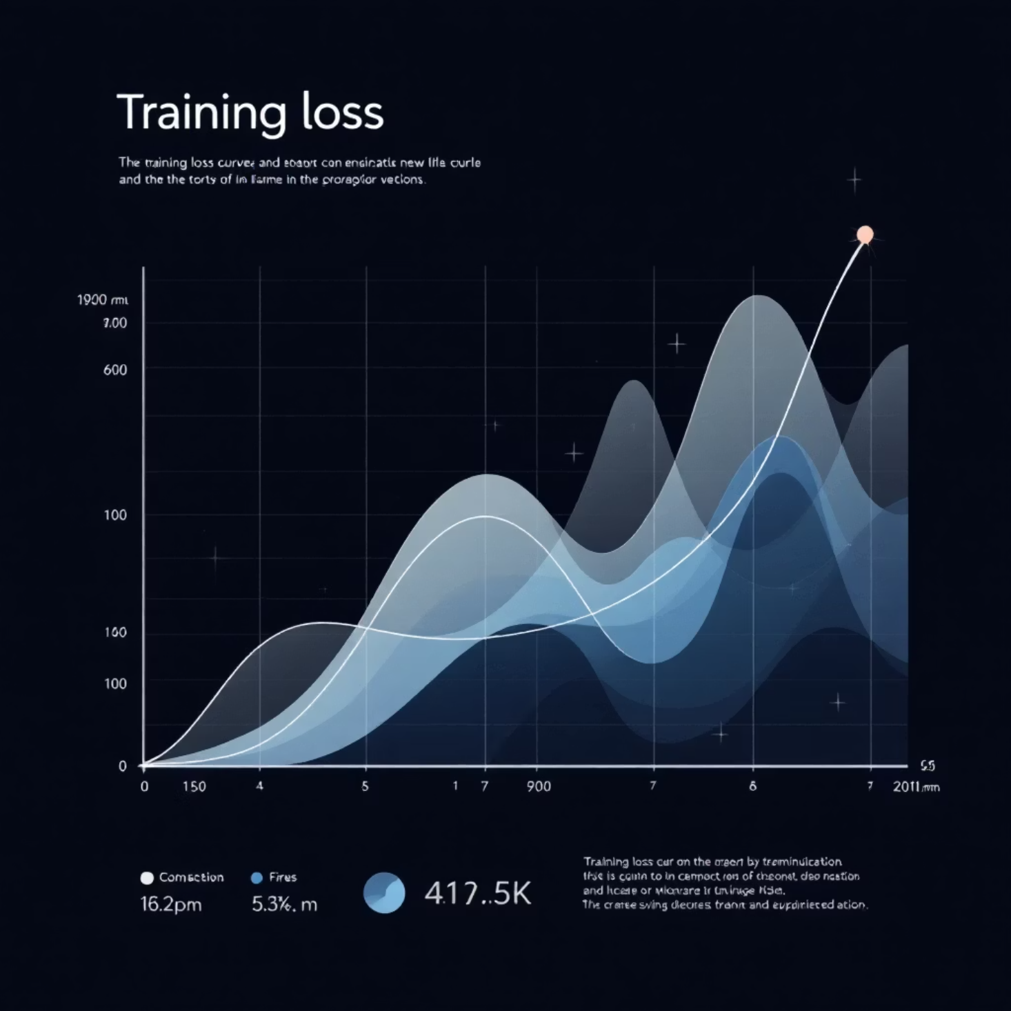
Training Performance
Rapid Convergence
The model demonstrates rapid and stable convergence, achieving optimal performance within approximately 10 training epochs. Validation loss consistently follows training loss with minimal gap, indicating no overfitting.
The validation accuracy curve closely tracks training accuracy, confirming the model's ability to learn discriminative features without compromising generalization.

Slide 8


Classification Results
98%
99%
99%
Overall Accuracy
Early Blight Precision
Late Blight Recall
Achieved on validation dataset
Highest precision score
Excellent disease detection
Class
Precision
Recall
F1-Score
Early Blight
0.99
0.98
0.98
Late Blight
0.96
0.99
0.97
Healthy Potato
1.00
0.90
0.95

Slide 9
Advantages & Impact
Fast Training
Lightweight Design
Real-World Ready
Converges within 10 epochs compared to 50+ epochs for traditional deep models
Significantly reduced parameters through Global Average Pooling, suitable for edge devices
Practical solution for resource-constrained agricultural settings and mobile deployment

Slide 10

Conclusion & Future Directions
Key Achievement
This study demonstrates that compact CNN architectures, when carefully designed, deliver high classification performance (98% accuracy) while significantly reducing training time and computational overhead.
Future Work
Evaluate on real-world datasets with diverse conditions
Extend to multi-crop and multi-disease classification
Deploy on edge devices for real-time field diagnosis

